Slide 1
Tutorial on Bubble Sort & Strings
16/05/2023

Slide 2
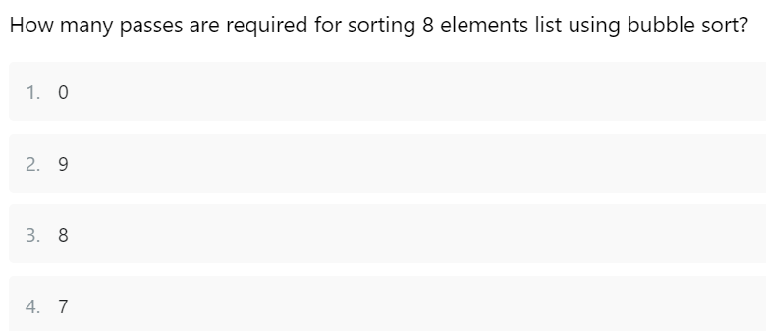

Slide 3
Option 4 - 7

Slide 4
#include <stdio.h>
void bubbleSort(int arr[], int n) {
int i, j;
for (i = 0; i < n-1; i++) {
for (j = 0; j < n-i-1; j++) {
if (arr[j] > arr[j+1]) {
int temp = arr[j];
arr[j] = arr[j+1];
arr[j+1] = temp;
}
}
}
}
int main() {
int arr[] = {5, 2, 8, 12, 1};
int n = sizeof(arr)/sizeof(arr[0]);
bubbleSort(arr, n);
for (int i = 0; i < n; i++) {
printf("%d ", arr[i]);
}
return 0;
}
What will be the output of the above code?
Options:
A) 1 2 5 8 12
B) 2 5 8 12 1
C) 1 5 2 8 12
D) 2 1 5 8 12

Slide 5
The code implements the bubble sort algorithm to sort the given array in ascending order. The input array is {5, 2, 8, 12, 1}. After sorting, the elements will be arranged in ascending order.
The correct option is
A) 1 2 5 8 12.

Slide 6
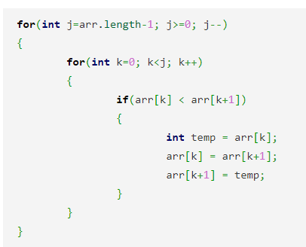
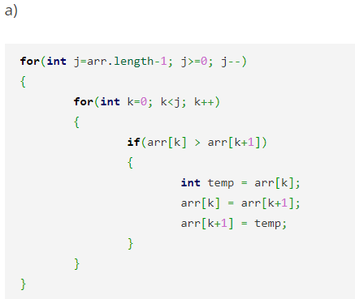
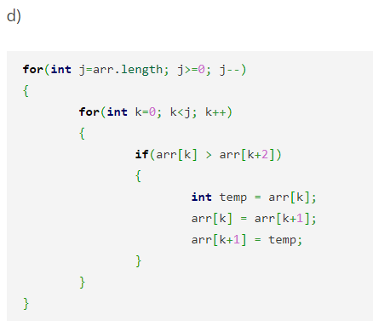
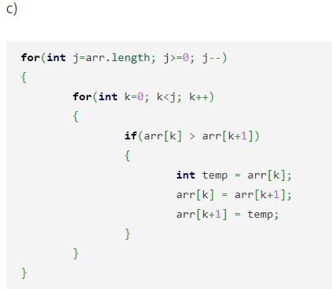
Select the appropriate code that performs bubble sort.

Slide 7
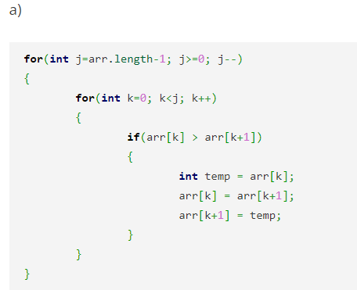

Slide 8
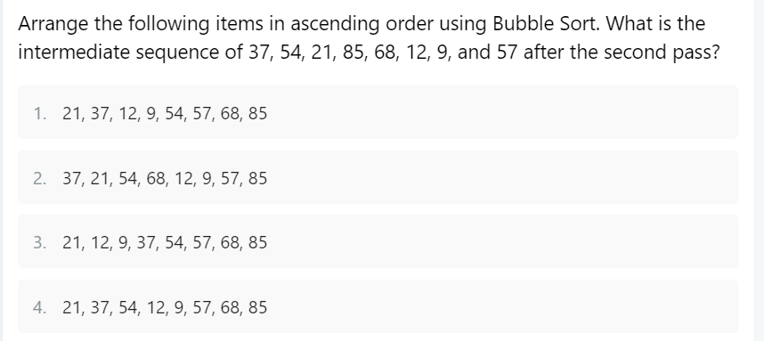

Slide 9
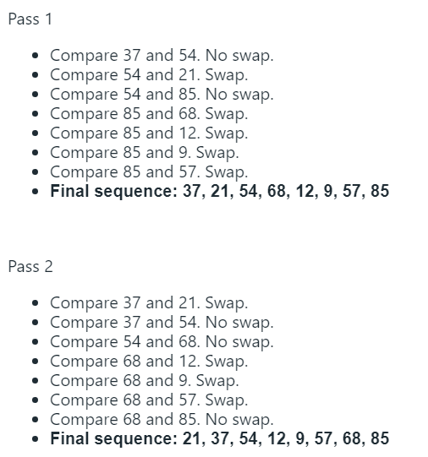

Slide 10
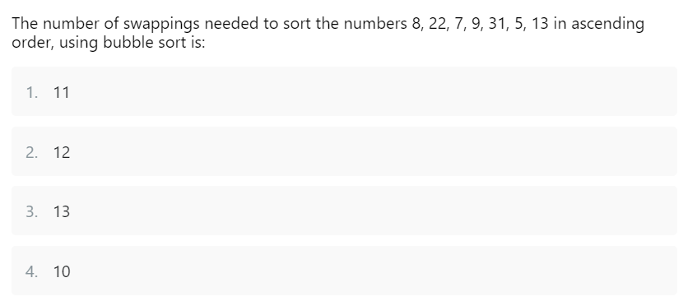

Slide 11
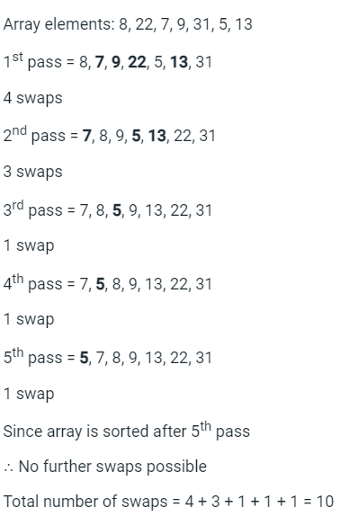

Slide 12
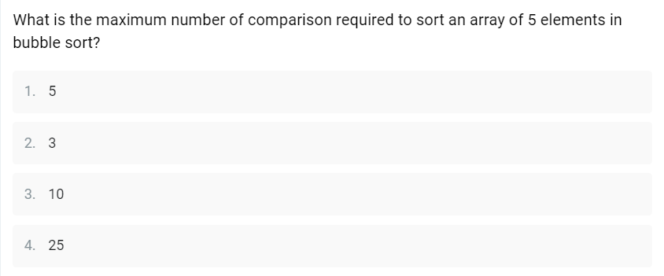

Slide 13
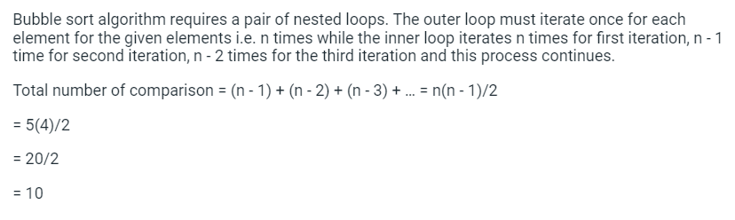

Slide 14
#include <stdio.h>
int stringLength(const char* str) {
int length = 0;
const char* ptr = str;
while (*ptr != '\0') {
length++;
ptr++;
}
return length;
}
int main() {
const char* str = "Hello, World!";
int len = stringLength(str);
printf("The length of the string '%s' is: %d\n", str, len);
return 0;
}
What will be the output of the above code?
Options:
The length of the string 'Hello, World!' is: 13
The length of the string 'Hello, World!' is: 12
The length of the string 'Hello, World!' is: 14
The length of the string 'Hello, World!' is: 11

Slide 15
The correct option is A) The length of the string 'Hello, World!' is: 13. Since there are 13 characters in the string, including the null character at the end, the function will correctly calculate the length as 13.

Slide 16
#include <stdio.h>
#include <string.h>
void stringCopy(char* dest, const char* src) {
char* firstWord = src;
char* secondWord = strchr(firstWord, ' ');
if (secondWord == NULL) {
secondWord = src + strlen(src);
}
int i = 0;
while (firstWord != secondWord) {
dest[i] = *firstWord;
firstWord++;
i++;
}
dest[i] = '\0';
}
int main() {
char dest[20];
const char* src = "Copy this string";
stringCopy(dest, src);
printf("The copied string is: %s\n", dest);
return 0;
}
What will be the output of the above code?
Options:
The copied string is: Copy this string
The copied string is: Copy
The copied string is: this
The copied string is: string
The strchr function returns a pointer to the first occurrence of the specified character in the string str. If the character is found, the returned pointer points to that character in str and any subsequent characters. If the character is not found, the function returns NULL.

Slide 17
The given code defines a function stringCopy that copies the characters from the source string to the destination string until it encounters either a space character or the null character. It stops copying when it reaches the first space character.
In the main function, a destination character array dest is declared with a size of 20 characters. The source string "Copy this string" is passed to the stringCopy function. The function starts copying the characters from the source string to the destination string until it reaches the space character after "Copy", and then it adds a null character to terminate the destination string.
The strchr function is used to find the position of the first occurrence of the space character (' ') in the source string. If the space character is not found, the strchr function returns NULL. The strlen function is used to determine the length of the source string if there is no space character present.
The correct option is B) The copied string is: Copy. The function stringCopy will copy the characters from the source string until it reaches the first space character, resulting in "Copy" being copied to the destination array dest.

Slide 18
int main() {
const char* str1 = "apple";
const char* str2 = "banana";
int result = strCompare(str1, str2);
if (result < 0)
printf("The strings are in lexicographical order.\n");
else if (result > 0)
printf("The strings are not in lexicographical order.\n");
else
printf("The strings are identical.\n");
return 0;
}
#include <stdio.h>
int strCompare(const char* str1, const char* str2) {
while (*str1 == *str2) {
if (*str1 == '\0')
return 0;
str1++;
str2++;
}
return *str1 - *str2;
}
The strings are in lexicographical order.
The strings are not in lexicographical order.
The strings are identical.
The output cannot be determined.

Slide 19
The given code defines a function strCompare that compares two strings lexicographically. It compares each corresponding character of the two strings until a difference is encountered or the null character is reached. The function returns the difference between the ASCII values of the differing characters.
In the main function, two string pointers str1 and str2 are initialized with "apple" and "banana" respectively. The strCompare function is called to compare the two strings, and the result is stored in the variable result. Based on the value of result, the appropriate message is printed using printf.
The correct option is A) The strings are in lexicographical order. The function strCompare will compare the strings "apple" and "banana" and determine that "apple" should come before "banana" in lexicographical order, as 'a' has a smaller ASCII value than 'b'.

Slide 20
Implement the strConcat function that concatenates the characters from the source string to the end of the destination string. The destination string is passed as the first argument and the source string as the second argument.

Slide 21
#include <stdio.h>
#include <string.h>
void strConcat(char* dest, const char* src) {
while (*dest != '\0') {
dest++;
}
while (*src != '\0') {
*dest = *src;
dest++;
src++;
}
*dest = '\0';
}
int main() {
char dest[20] = "Hello, ";
const char* src = "World!";
strConcat(dest, src);
printf("The concatenated string is: %s\n", dest);
return 0;
}

